Slide 1

How to Fireproof Your Computer from Jenny Bryan
Using R Projects and here::here()
Kat Hoffman
R-Ladies NYC Lightning Talk
June 19, 2019

Slide 2

“If the first line of your #rstats script is setwd("C:\Users\jenny\path\that\only\I\have"),
I will come into your lab and
SET YOUR COMPUTER ON FIRE.”
-Jenny Bryan

Slide 3

R Project: a shortcut to open RStudio and work on an individual project
Notes:
Think of RProjects as a shortcut to Rstudio that when clicked opens up an Rstudio window with the working directory already set to the folder the RProject shortcut is in

Slide 4
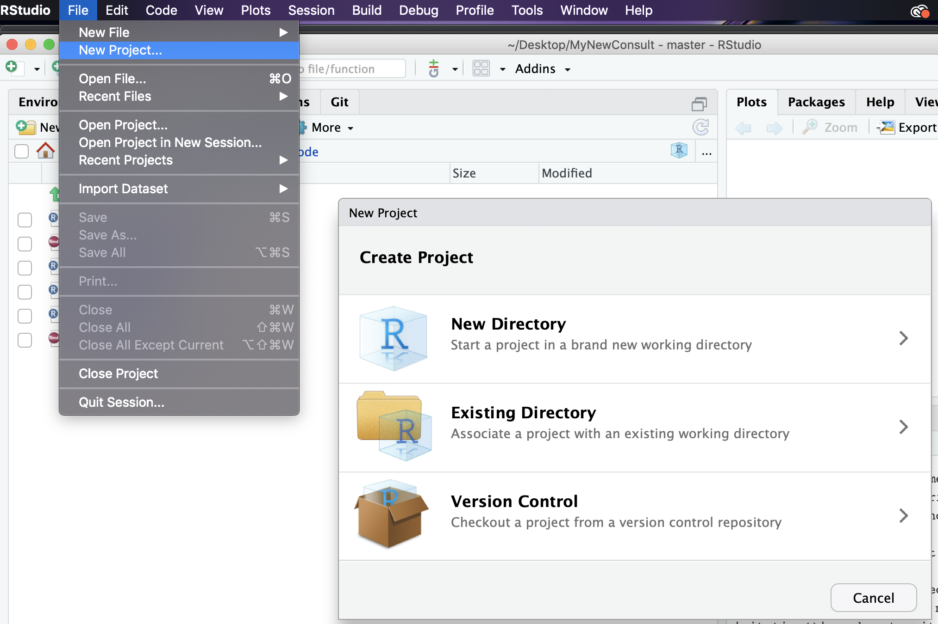
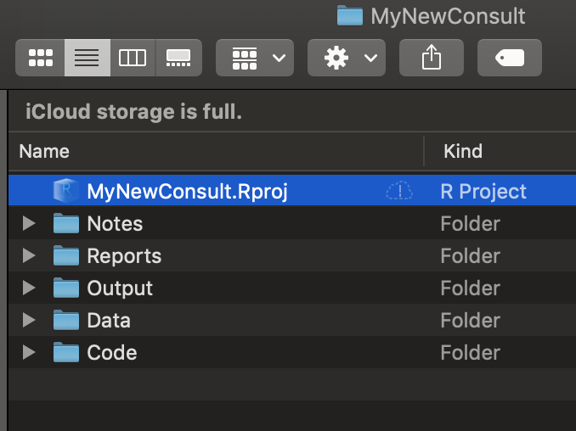
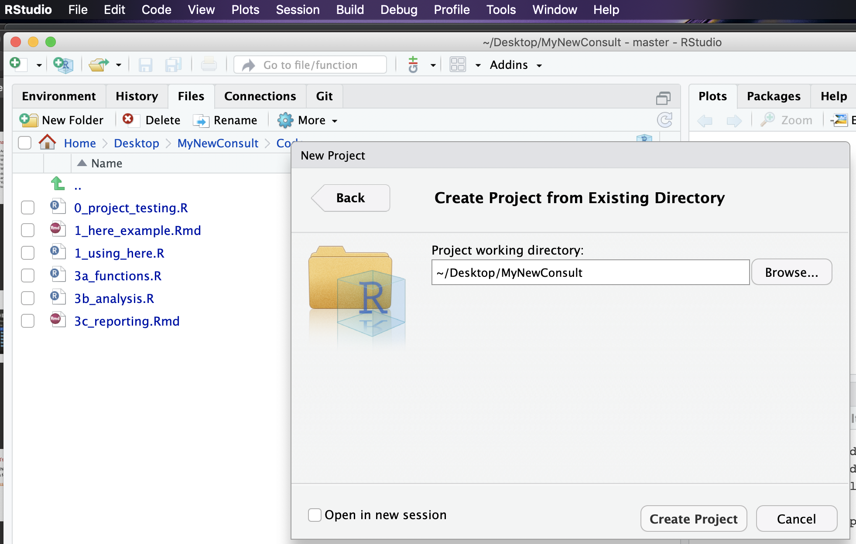
Screenshot of open Rstudio window with working directory in this folder
Notes:
Live code

Slide 5
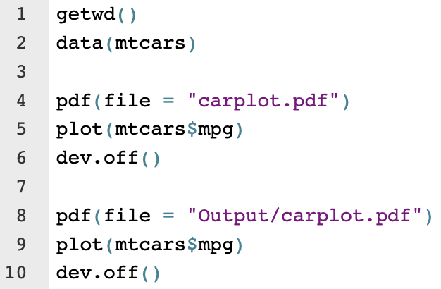
Let’s test our new R Project out...
Check out your working directory with getwd()
Make a plot and save it, then try saving it in an “Output” folder
Move the entire folder containing your R Project to a new location and try again
Notes:
Talk about how clara i can copy her code and all folders, and then run it perfectly fine on my research share drive folders because nothing relies on her folders
Show getwd() output
Show reading in csvs and saving a plot

Slide 6
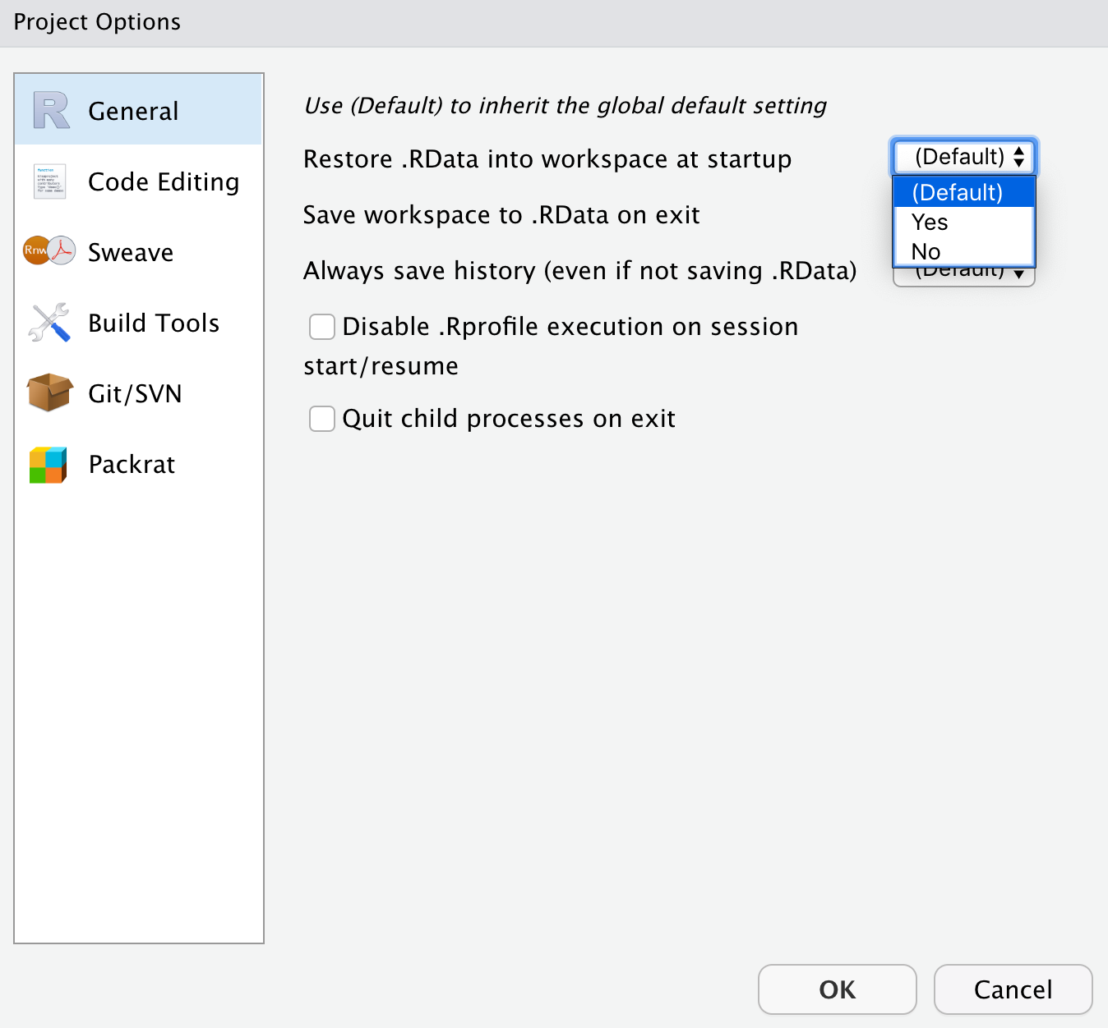
RProjects are so cool
Version control with Git by automatically starting a Git repository when you make a new R Project - SCREENSHOT OF GIT
Set Project-specific options (like never save R history)
Use packrat to keep track of which package versions you are using
How could projects possibly get any better?
Notes:
Talk about how clara i can copy her code and all folders, and then run it perfectly fine on my research share drive folders because nothing relies on her folders

Slide 7

The here package!
Animation by Allison Horst
@allison_horst

Slide 8
What the heck is the here package?
A package with one main function: here()
here() is a wrapper function that helps establish file paths by searching for a file path that should be your home or “root” directory
See the full heuristics for that decision here
All we need to know for now… If you have an R Project, it will always locate that R Project as the root directory
This is super helpful for RMarkdown reports, because an .Rmd file’s root directory is wherever that .Rmd file is located

Slide 9
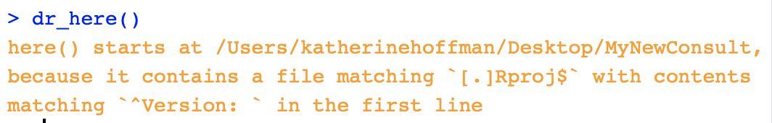
here::here() in action
Loading the here package returns a message letting you know what your working directory has been recognized to be (if you’ve started an R Project, that’s where it defaults!) You can double check that with...

Slide 10
Practice
Resources
Interactive codes to try https://github.com/hoffmakl/Rproj-here-tutorial
Jenny Bryan’s Project-Oriented workflow tutorial: https://www.tidyverse.org/articles/2017/12/workflow-vs-script/
Jenny Bryan’s here::here() explanation: https://github.com/jennybc/here_here/blob/master/README.md
Malcolm Barrett on why you should use here() in addition to RProjects: https://malco.io/2018/11/05/why-should-i-use-the-here-package/

